Slide 1
INTRODUCTION TO
ALGORITHMS
FOURTH EDITION

Slide 2
LECTURE NOTES FOR CHAPTER 6
Heapsort

Slide 3
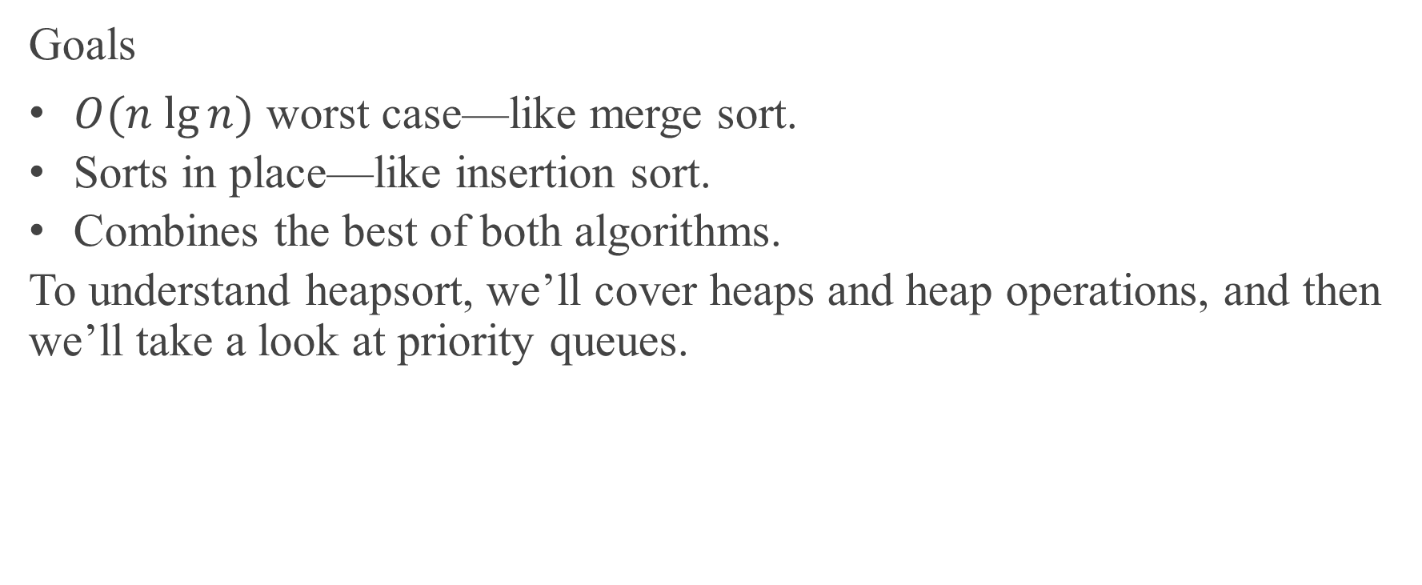
CHAPTER 6 OVERVIEW
Goals
$O(n lg⁡n)$ worst case—like merge sort.
Sorts in place—like insertion sort.
Combines the best of both algorithms.
To understand heapsort, we’ll cover heaps and heap operations, and then we’ll take a look at priority queues.

Slide 4
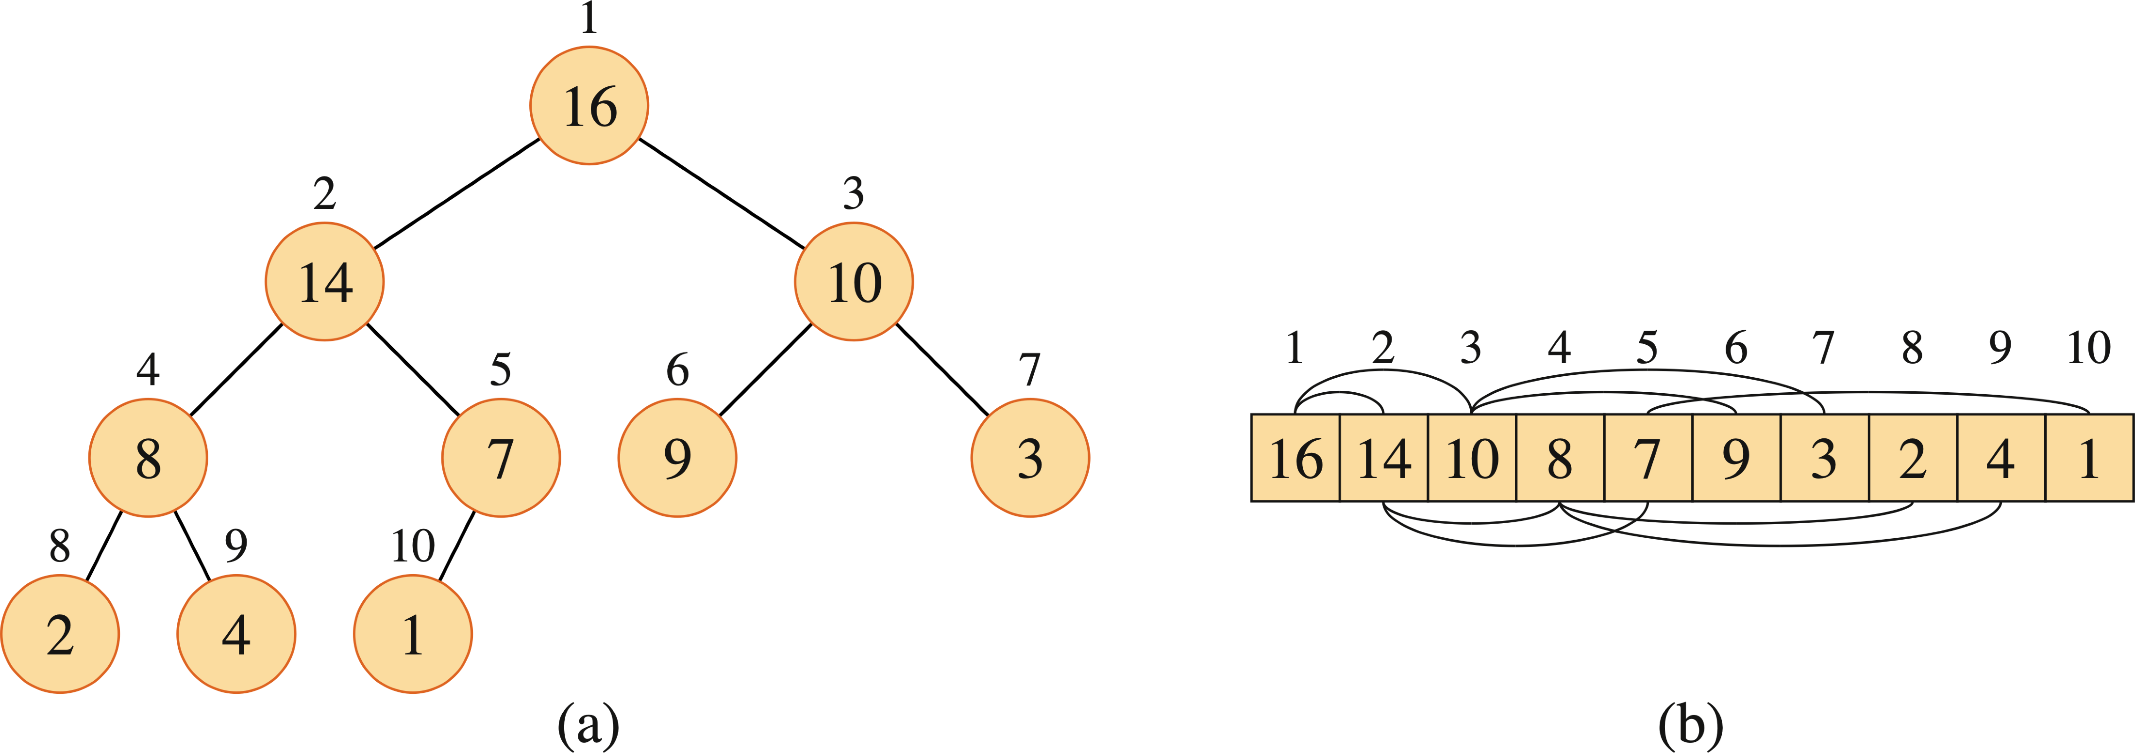
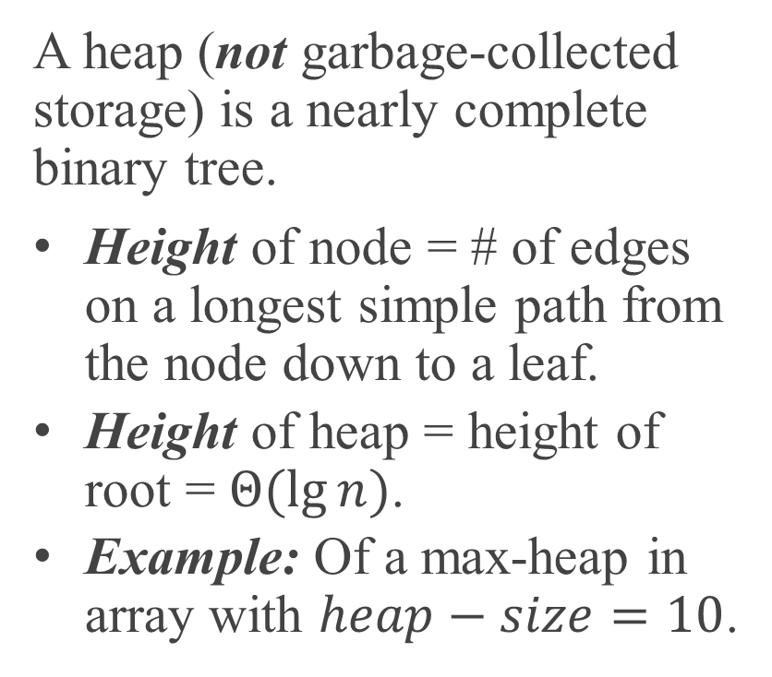
HEAP DATA STRUCTURE
A heap (not garbage-collected storage) is a nearly complete binary tree.
Height of node = # of edges on a longest simple path from the node down to a leaf.
Height of heap = height of root = $Θ(lg⁡n)$.
Example: Of a max-heap in array with $heap−size=10$.

Slide 5
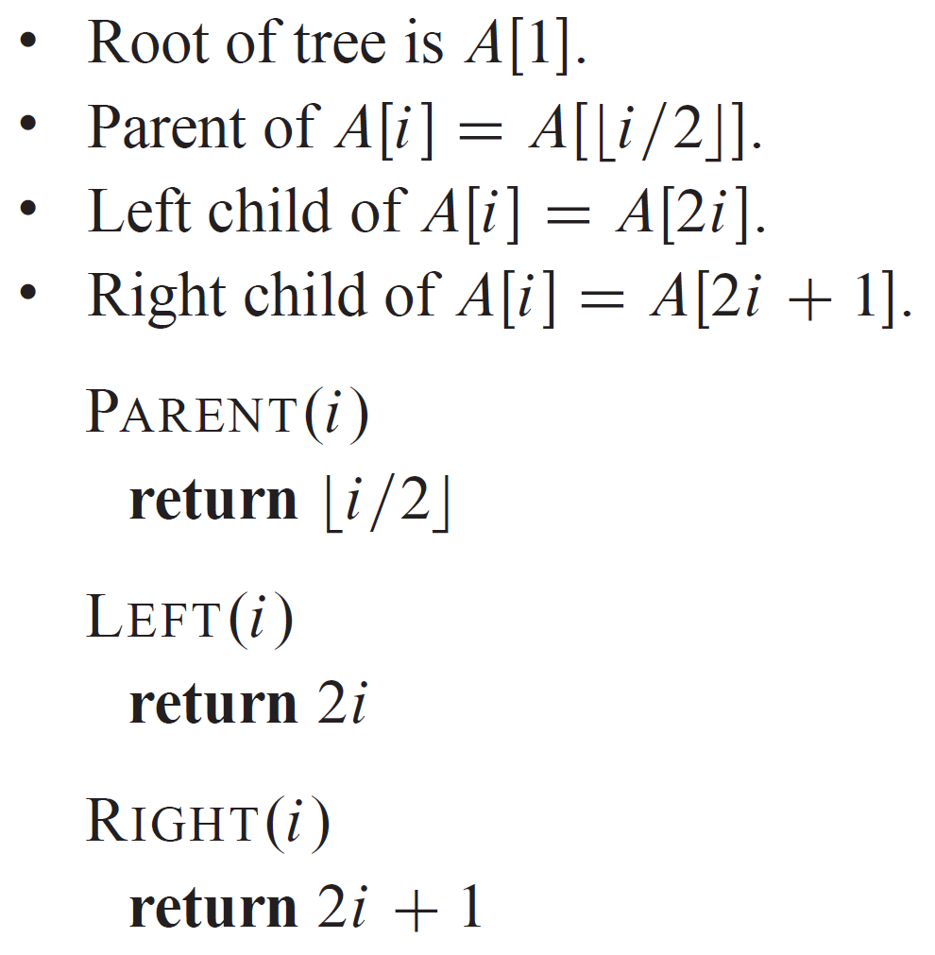
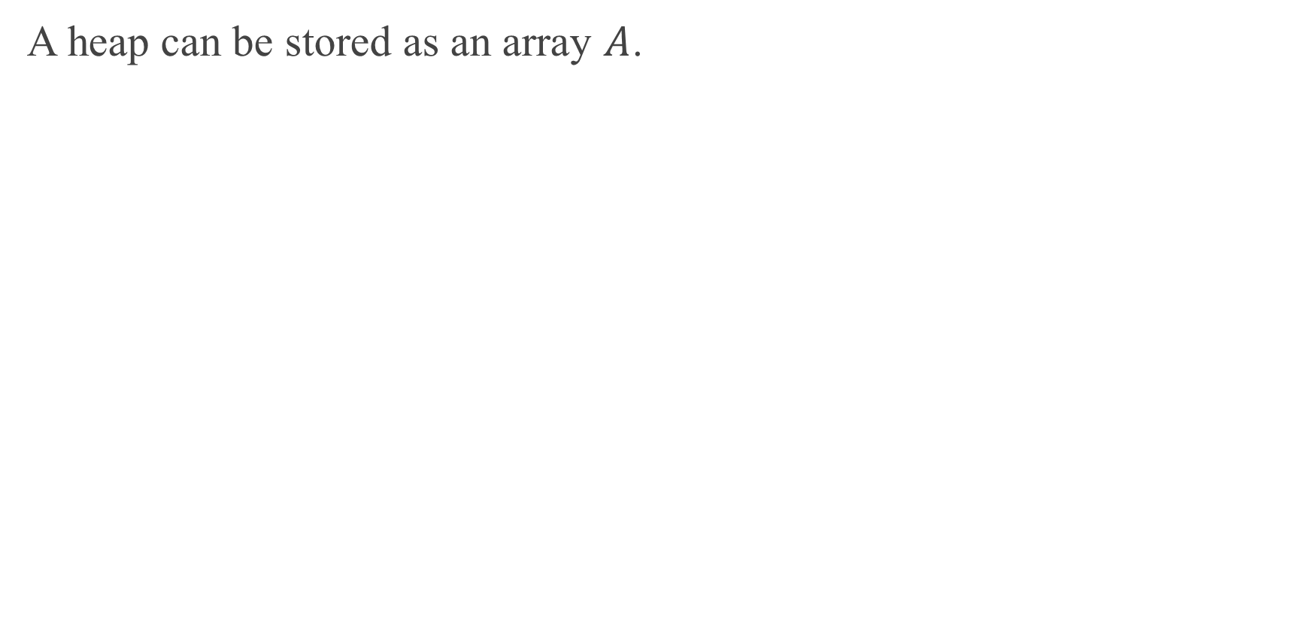
HEAP DATA STRUCTURES (continued)
A heap can be stored as an array $A$.

Slide 6
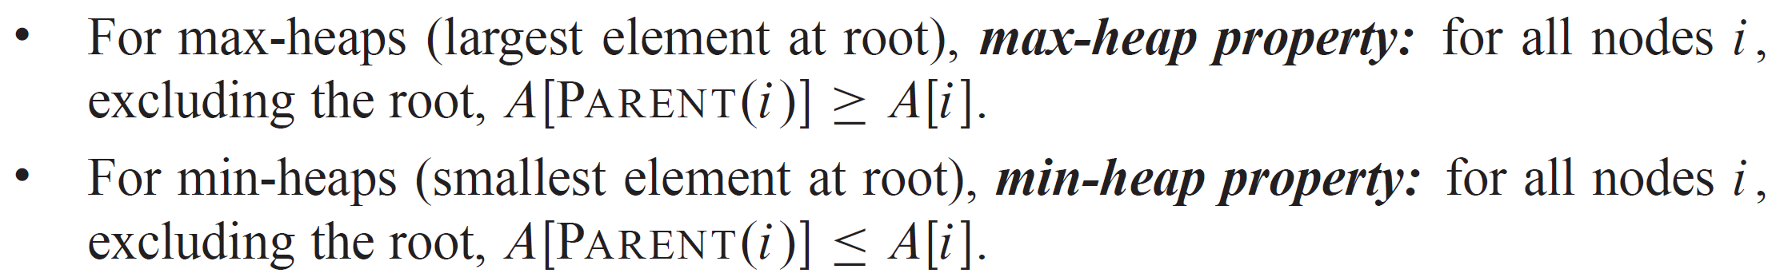
EXAMPLE

Slide 7
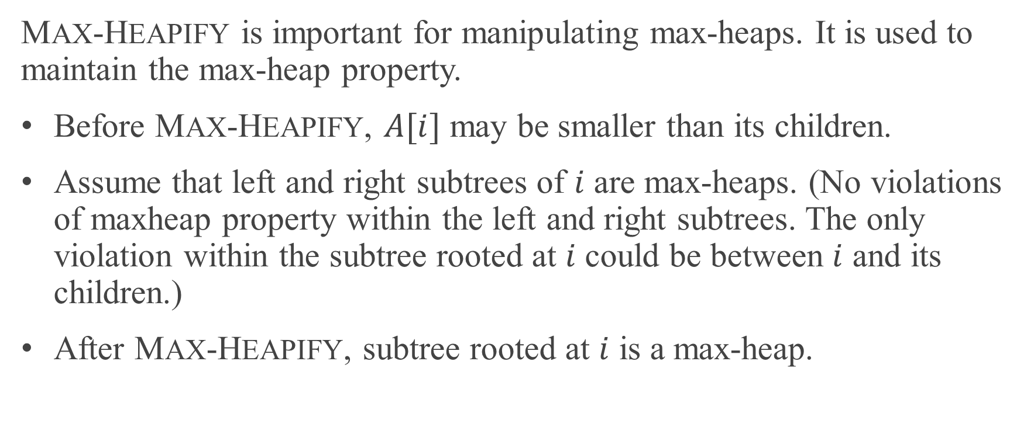
MAINTAINING THE HEAP PROPERTY
MAX-HEAPIFY is important for manipulating max-heaps. It is used to maintain the max-heap property.
Before MAX-HEAPIFY, $A[i]$ may be smaller than its children.
Assume that left and right subtrees of $i$ are max-heaps. (No violations of maxheap property within the left and right subtrees. The only violation within the subtree rooted at $i$ could be between $i$ and its children.)
After MAX-HEAPIFY, subtree rooted at $i$ is a max-heap.

Slide 8
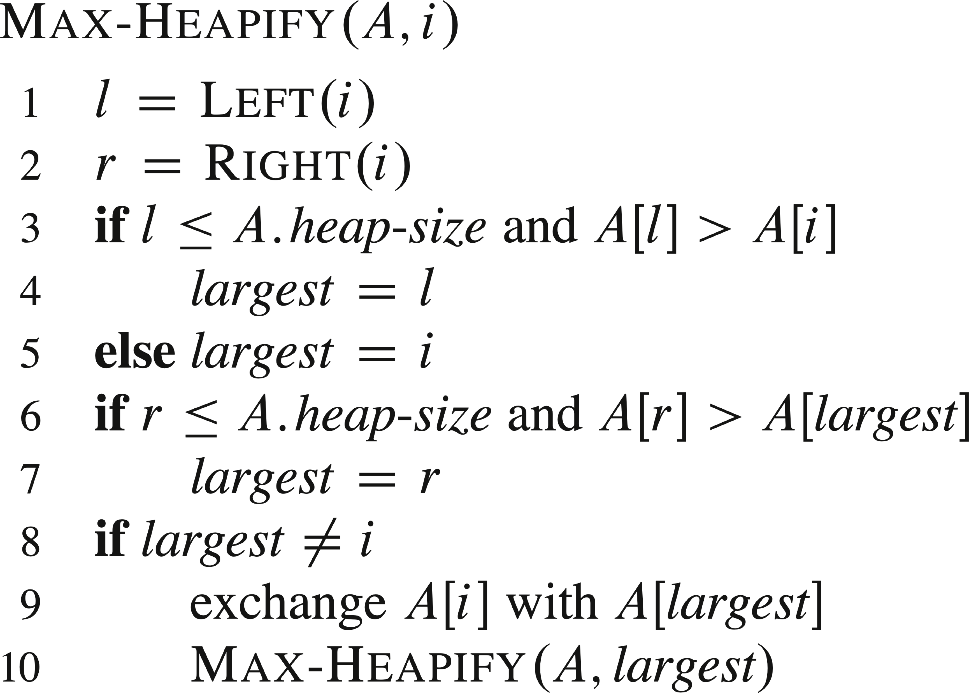
PSEUDOCODE

Slide 9
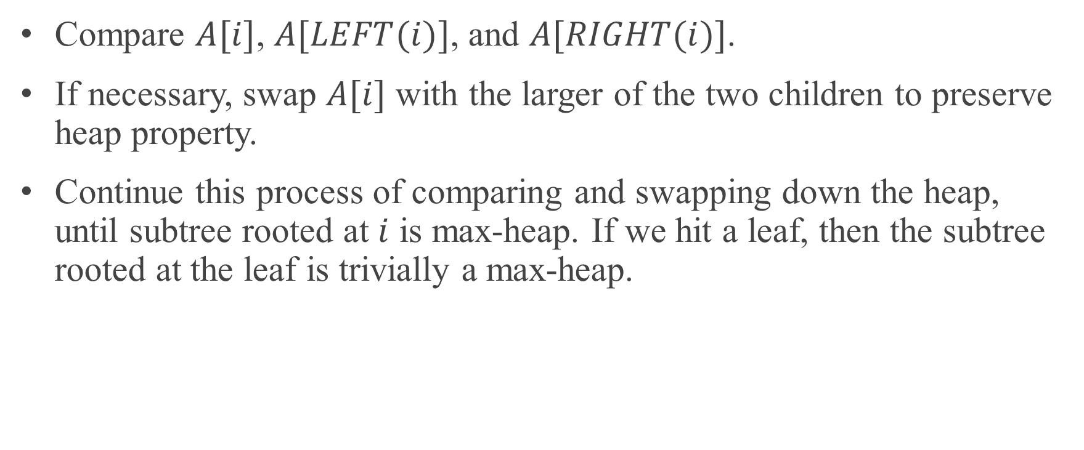
THE WAY MAX-HEAPIFY WORKS
Compare $A[i]$, $A[LEFT(i)]$, and $A[RIGHT(i)]$.
If necessary, swap $A[i]$ with the larger of the two children to preserve heap property.
Continue this process of comparing and swapping down the heap, until subtree rooted at $i$ is max-heap. If we hit a leaf, then the subtree rooted at the leaf is trivially a max-heap.

Slide 10



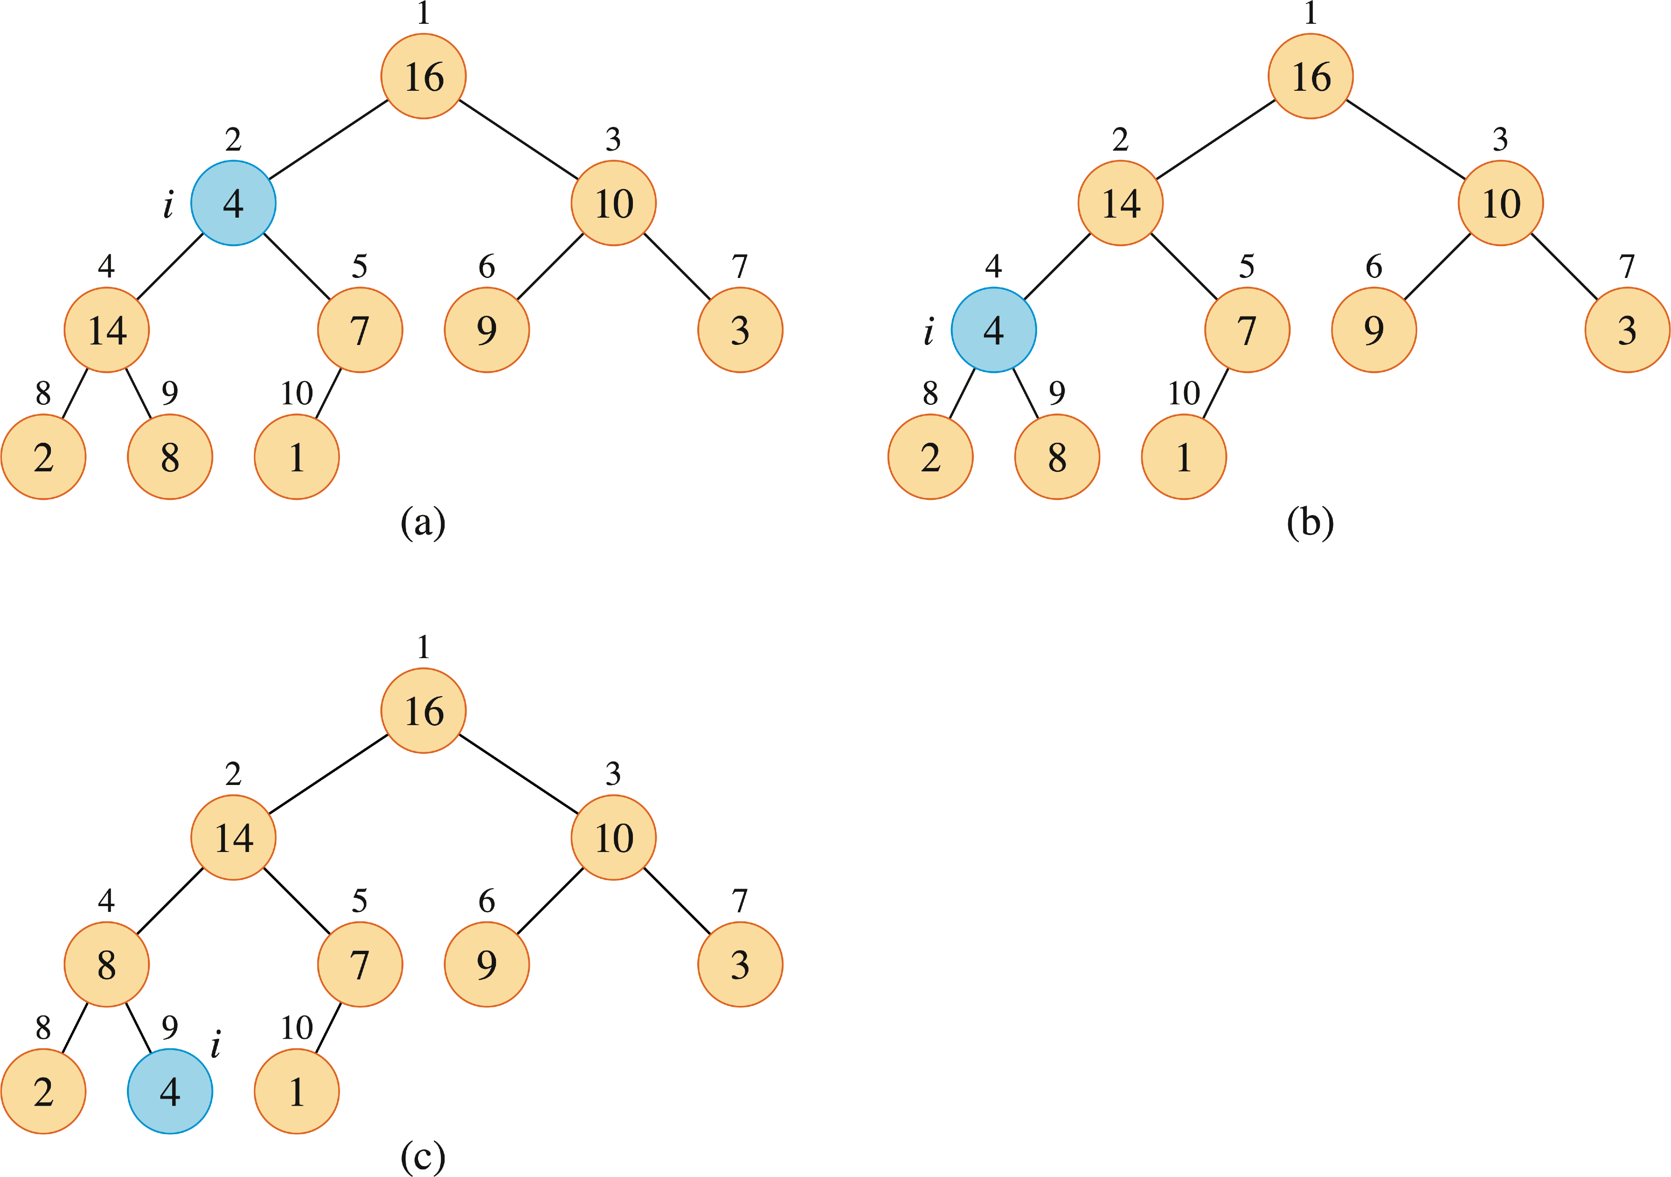
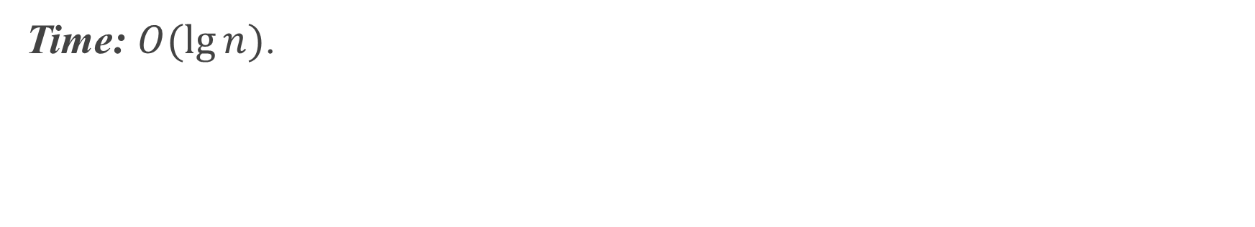
EXAMPLE
Run MAX-HEAPIFY on the following heap example.
Time: $O(lg⁡n)$.

Slide 11
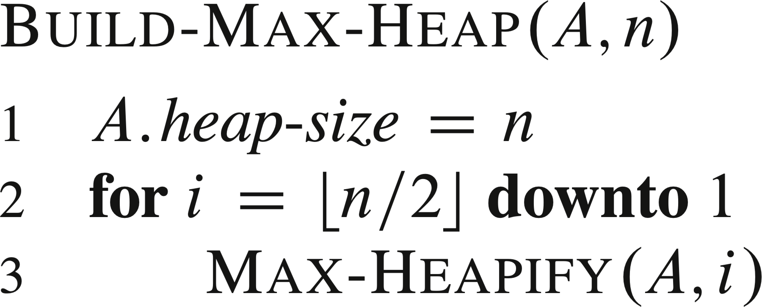
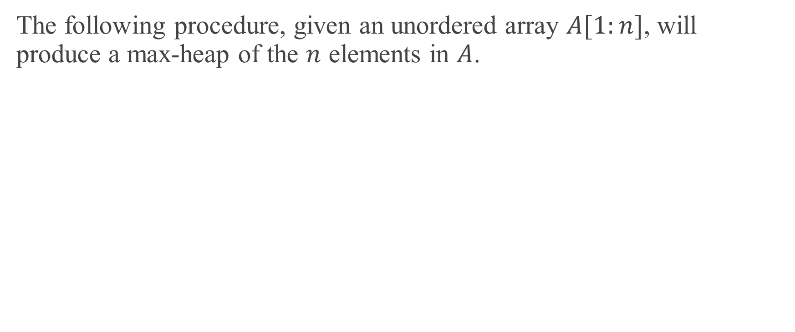
BUILDING A HEAP
The following procedure, given an unordered array $A[1:n]$, will produce a max-heap of the $n$ elements in $A$.

Slide 12
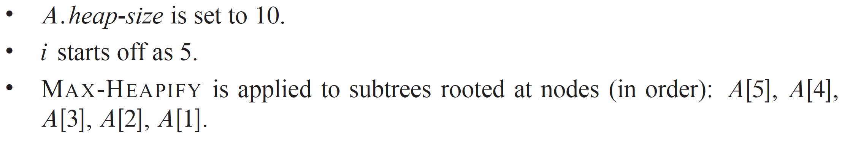
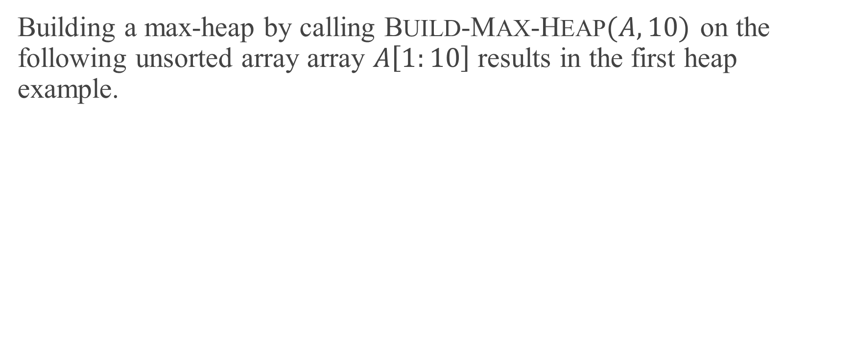
EXAMPLE
Building a max-heap by calling BUILD-MAX-HEAP$(A,10)$ on the following unsorted array array $A\left[1:10\right]$ results in the first heap example.

Slide 13
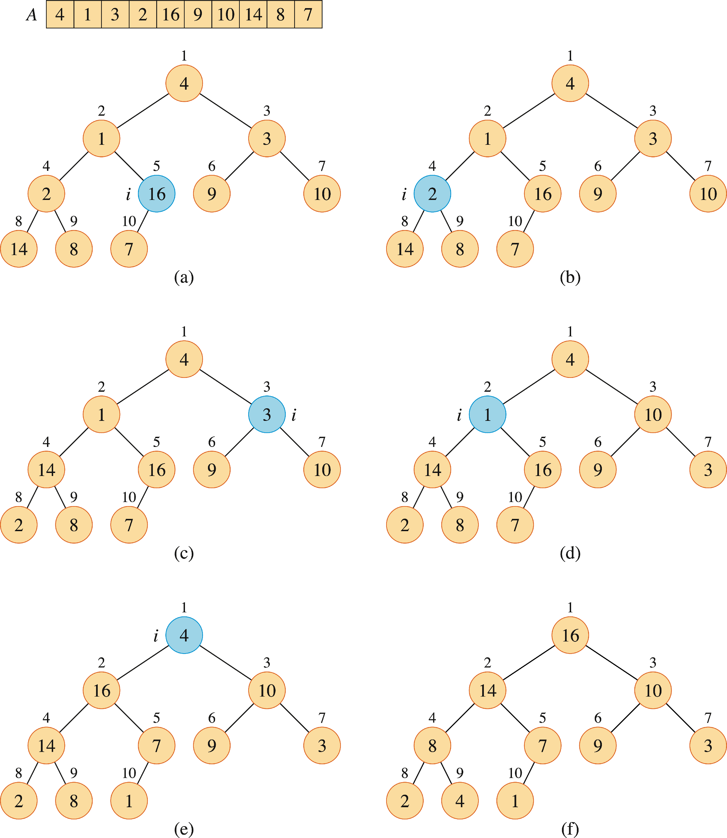



EXAMPLE (continued)

Slide 14
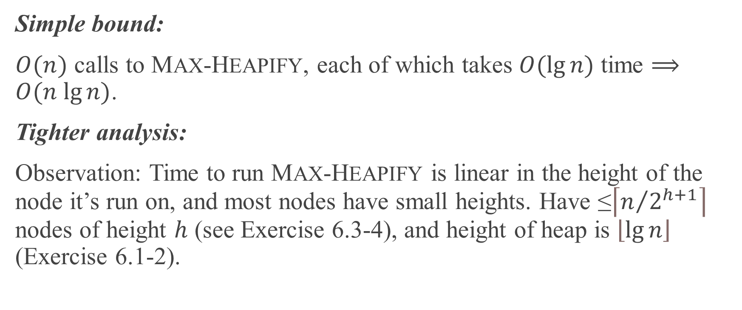
ANALYSIS
Simple bound:
$O(n)$ calls to MAX-HEAPIFY, each of which takes $O(lg⁡n)$ time $⟹$ $O(n lg⁡n)$.
Tighter analysis:
Observation: Time to run MAX-HEAPIFY is linear in the height of the node it’s run on, and most nodes have small heights. Have ≤$\left\lceil n/{2^{h+1}}\right\rceil$ nodes of height $h$ (see Exercise 6.3-4), and height of heap is $\left\lfloor \lg{n}\right\rfloor$ (Exercise 6.1-2).

Slide 15
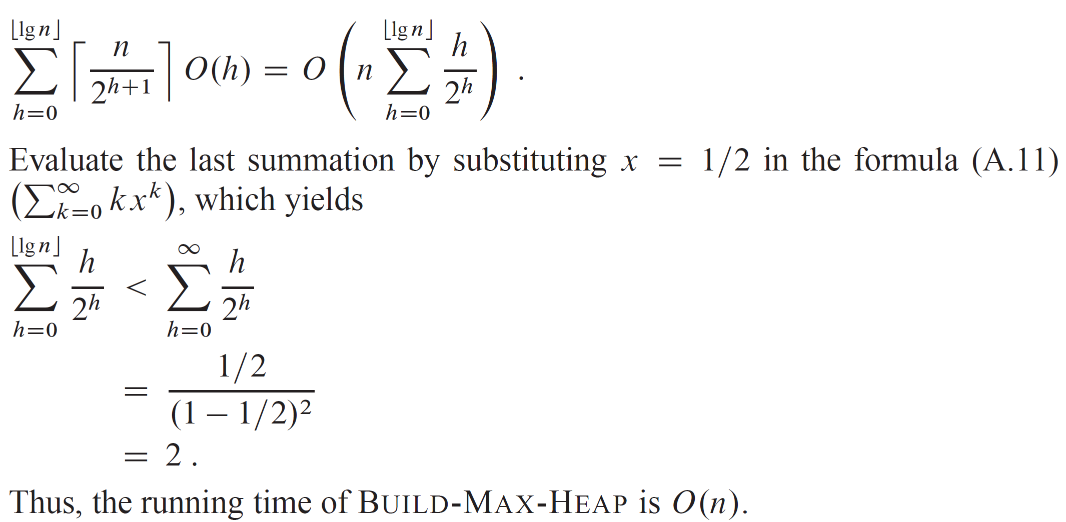
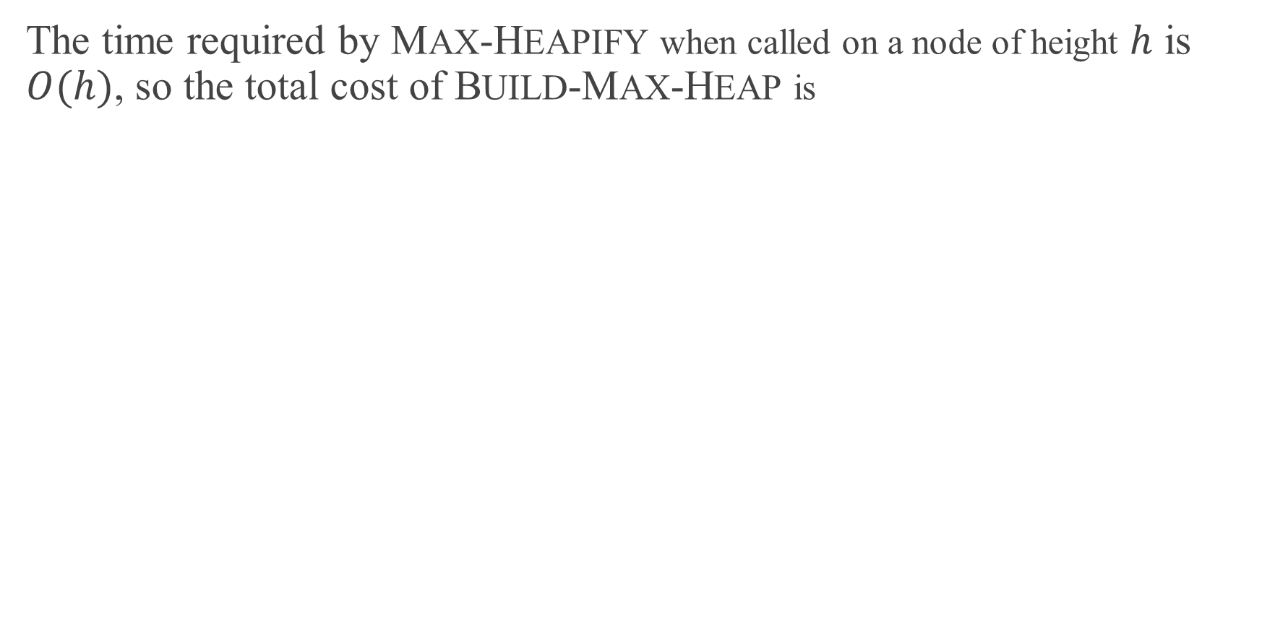
ANALYSIS (continued)
The time required by MAX-HEAPIFY when called on a node of height $h$ is $O(h)$, so the total cost of BUILD-MAX-HEAP is

Slide 16
THE HEAPSORT ALGORITHM
Given an input array, the heapsort algorithm acts as follows:
Builds a max-heap from the array.
Starting with the root (the maximum element), the algorithm places the maximum element into the correct place in the array by swapping it with the element in the last position in the array.
“Discard” this last node (knowing that it is in its correct place) by decreasing the heap size, and calling MAX-HEAPIFY on the new (possibly incorrectly-placed) root.
Repeat this “discarding” process until only one node (the smallest element) remains, and therefore is in the correct place in the array.

Slide 17
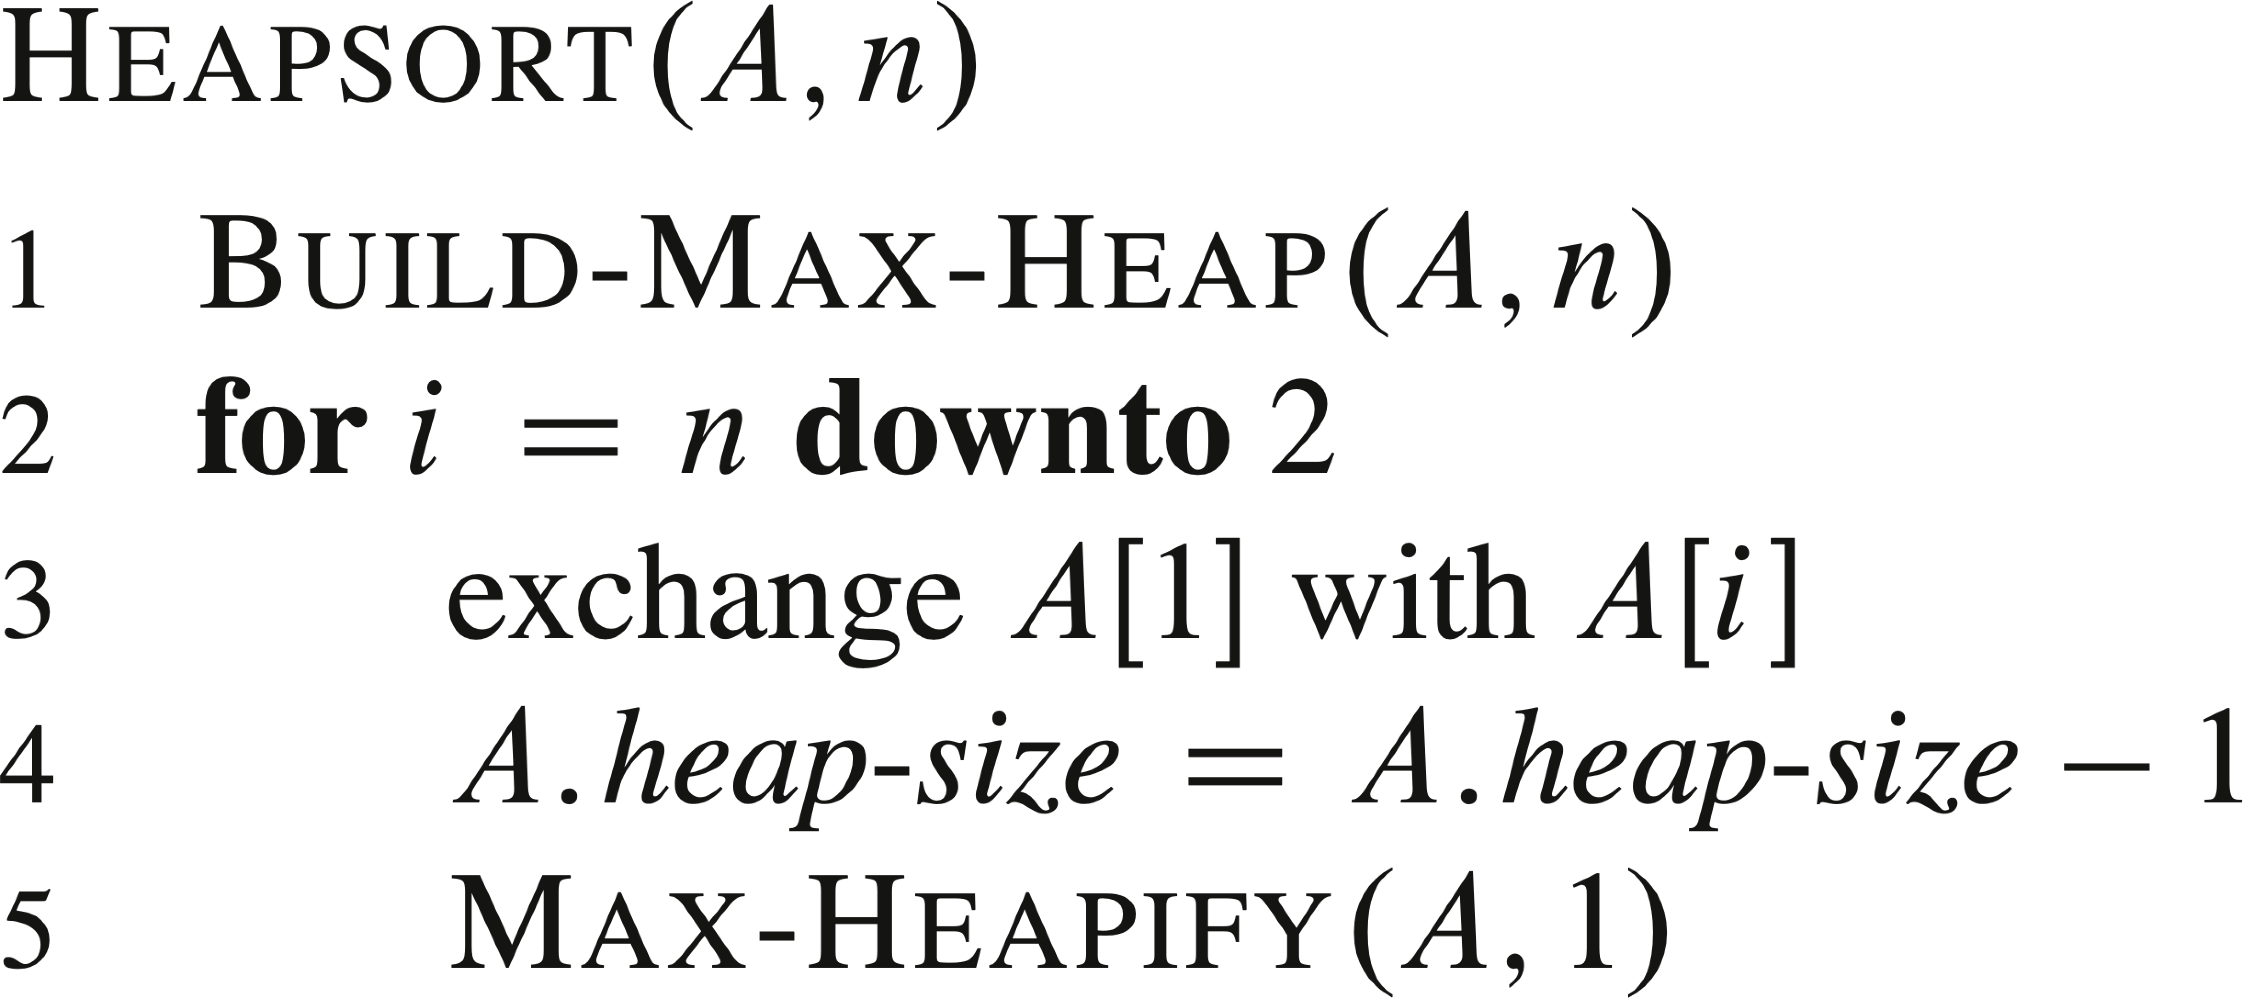
PSEUDOCODE

Slide 18
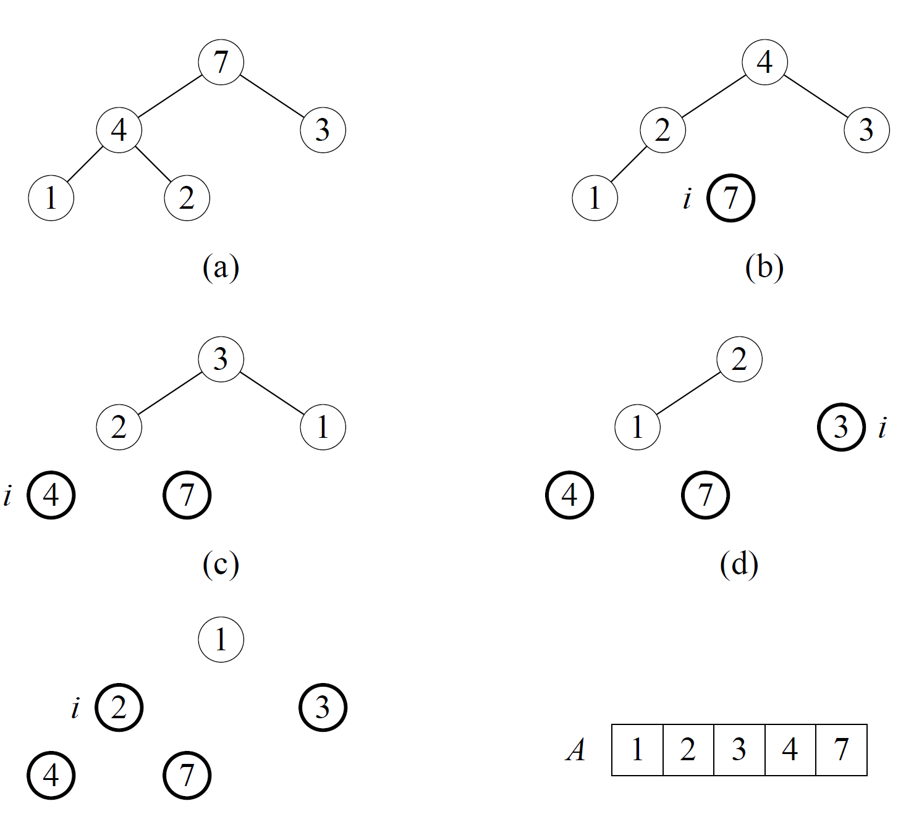
EXAMPLE
Sort an example heap on the board. [Nodes with heavy outline are no longer in the heap.]

Slide 19
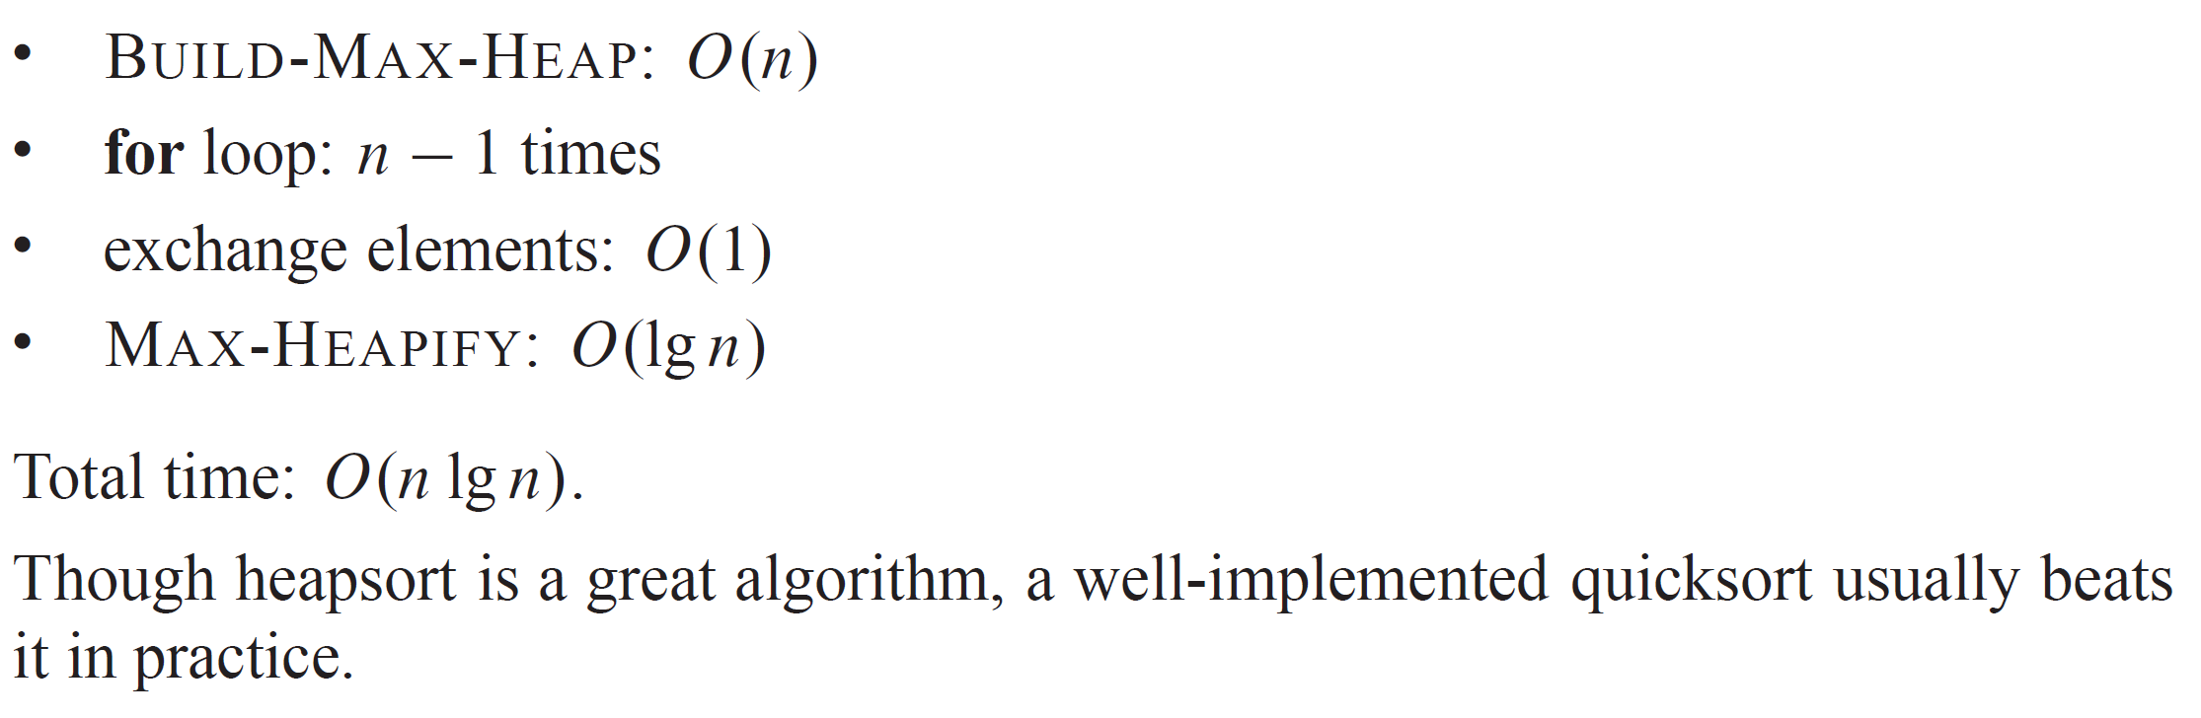
ANALYSIS

Slide 20
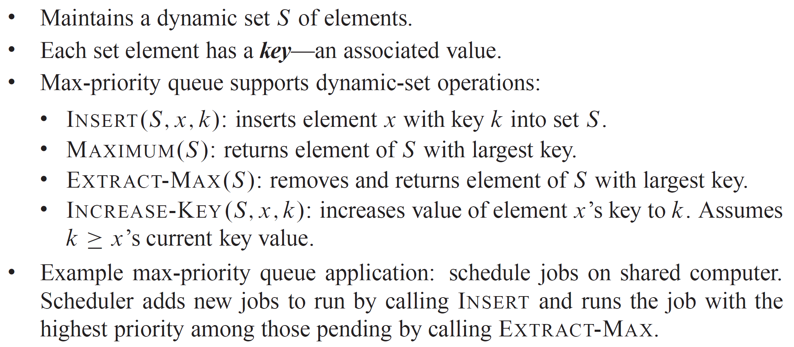
PRIORITY QUEUE

Slide 21
PRIORITY QUEUE (continued)
Elements in the priority queue correspond to objects in the application that uses the priority queue. Each object contains a key. Need to be able to map between application objects and array indices in the heap. Two suggested ways:
Each heap element has a handle that allows access to an object in the application, and each object in the application has a handle (likely an array index) to access the heap element. Good software engineering practice is to make the handles opaque to the surrounding code.
Store within the priority queue a mapping from application objects to array indices in the heap.
Advantage: application objects don’t need to use handles.
Disadvantage: need to establish and maintain the mapping.
One option would be to use a hash table (see Chapter 11).

Slide 22
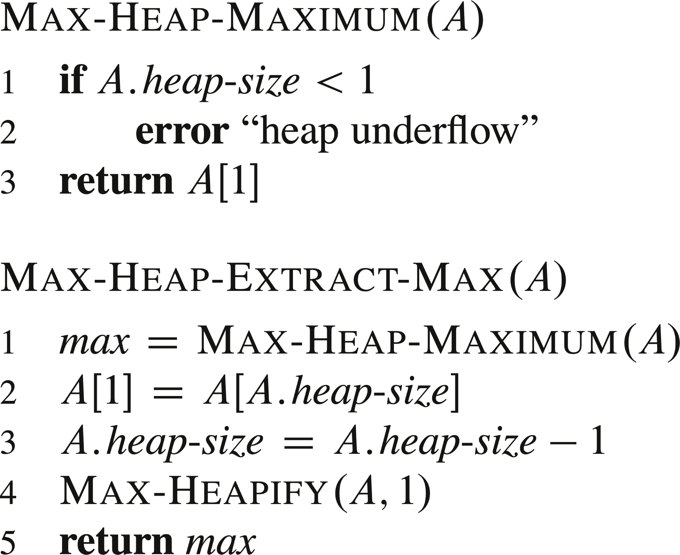
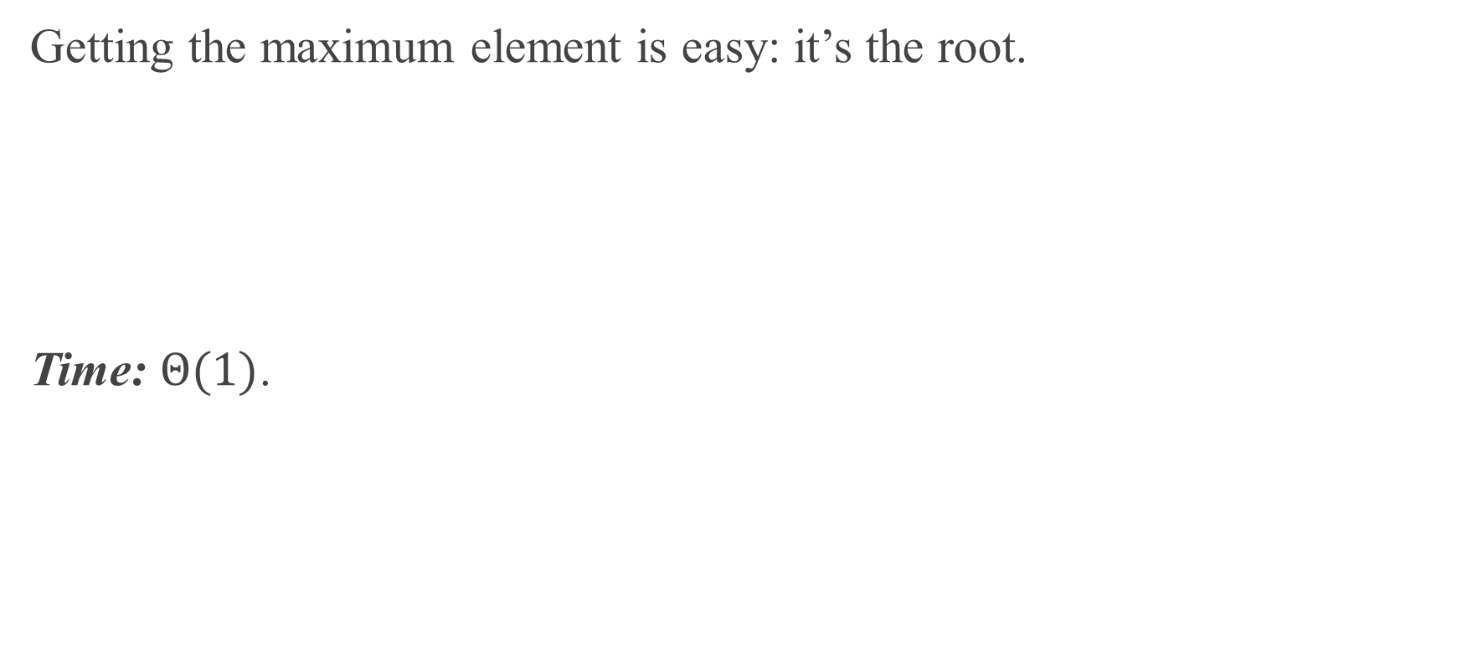
FINDING THE MAXIMUM ELEMENT
Getting the maximum element is easy: it’s the root.
Time: $Θ(1)$.

Slide 23
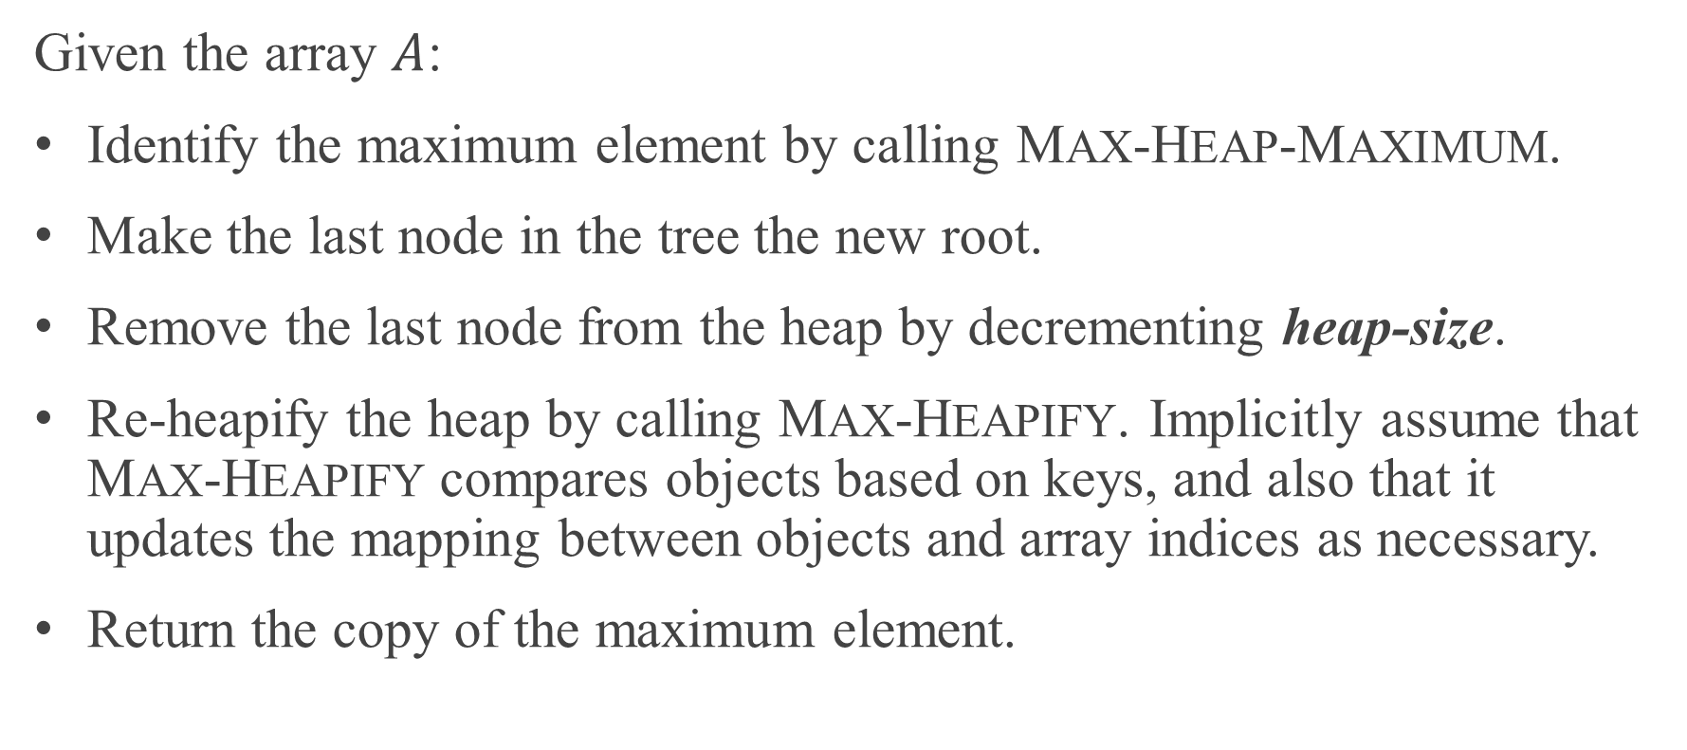
EXTRACTING THE MAXIMUM ELEMENT
Given the array $A$:
Identify the maximum element by calling MAX-HEAP-MAXIMUM.
Make the last node in the tree the new root.
Remove the last node from the heap by decrementing heap-size.
Re-heapify the heap by calling MAX-HEAPIFY. Implicitly assume that MAX-HEAPIFY compares objects based on keys, and also that it updates the mapping between objects and array indices as necessary.
Return the copy of the maximum element.

Slide 24
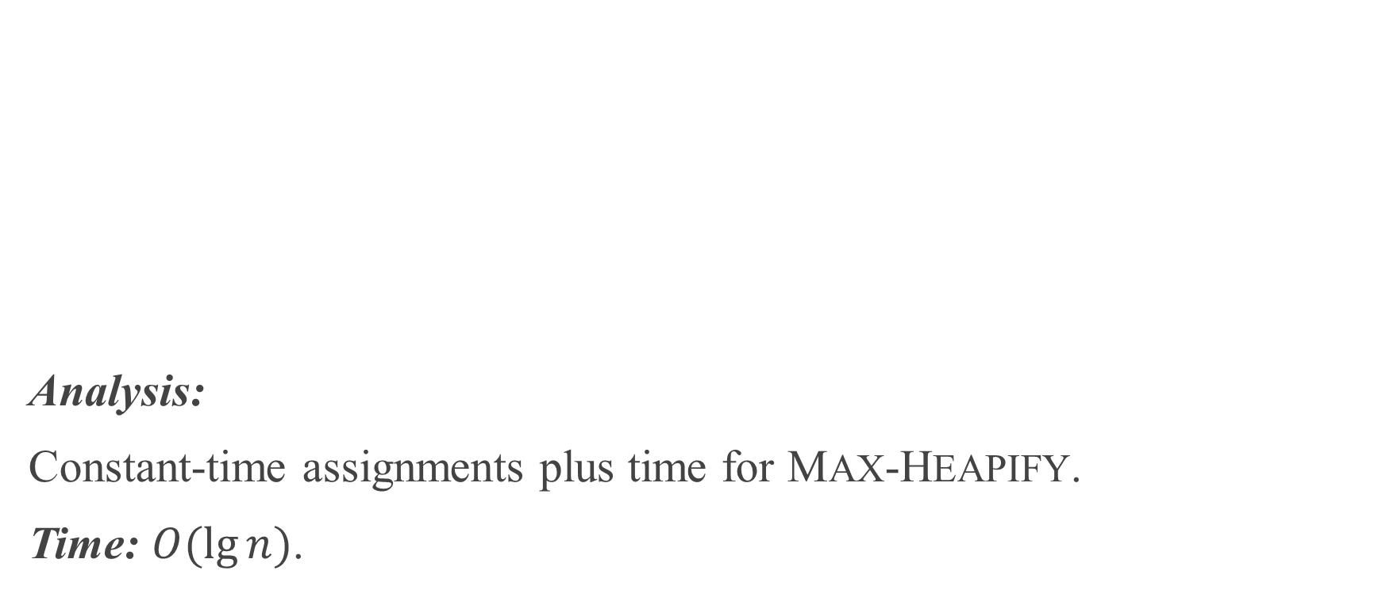
EXTRACTING THE MAXIMUM ELEMENT (continued)
Analysis:
Constant-time assignments plus time for MAX-HEAPIFY.
Time: $O(\lg{n})$.

Slide 25
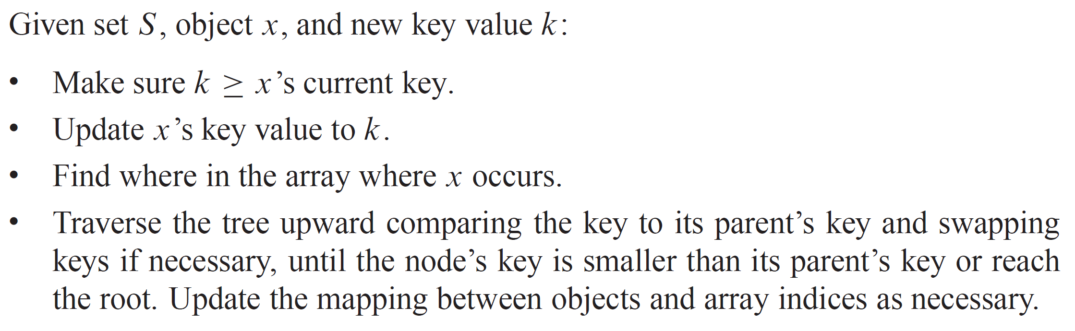
INCREASING THE VALUE OF AN OBJECT’S KEY

Slide 26
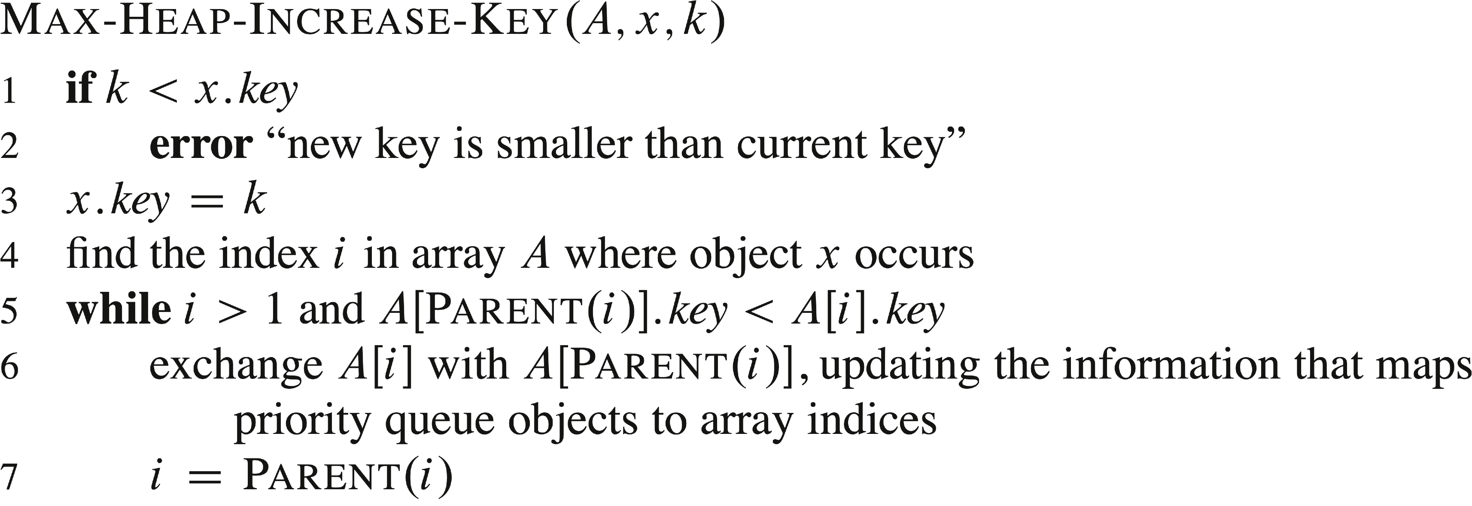
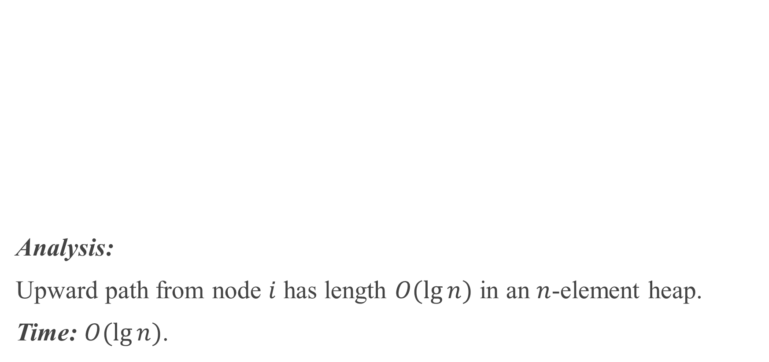
INCREASING THE VALUE OF AN OBJECT’S KEY(continued)
Analysis:
Upward path from node $i$ has length $O(\lg{n})$ in an $n$-element heap.
Time: $O(\lg{n})$.

Slide 27
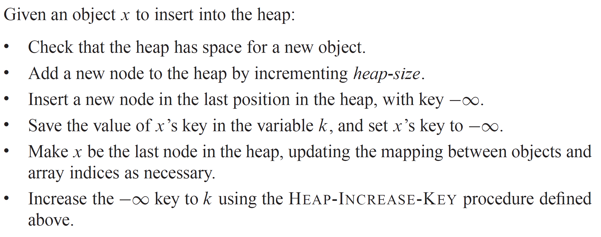
INSERTING INTO THE HEAP

Slide 28
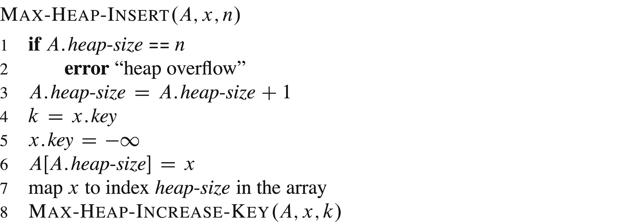
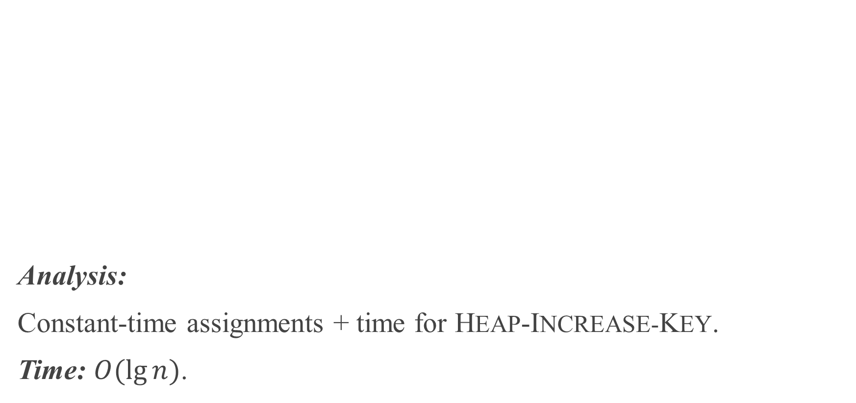
INSERTING INTO THE HEAP (continued)
Analysis:
Constant-time assignments + time for HEAP-INCREASE-KEY.
Time: $O(\lg{n})$.

